Slide 1

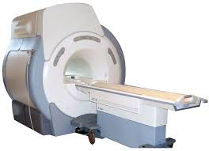


Exercise
(Order Counterbalanced)
fMRI Scans
Computerized Stroop
seated Rest
30 minutes
80 minutes
20 minutes

Slide 2
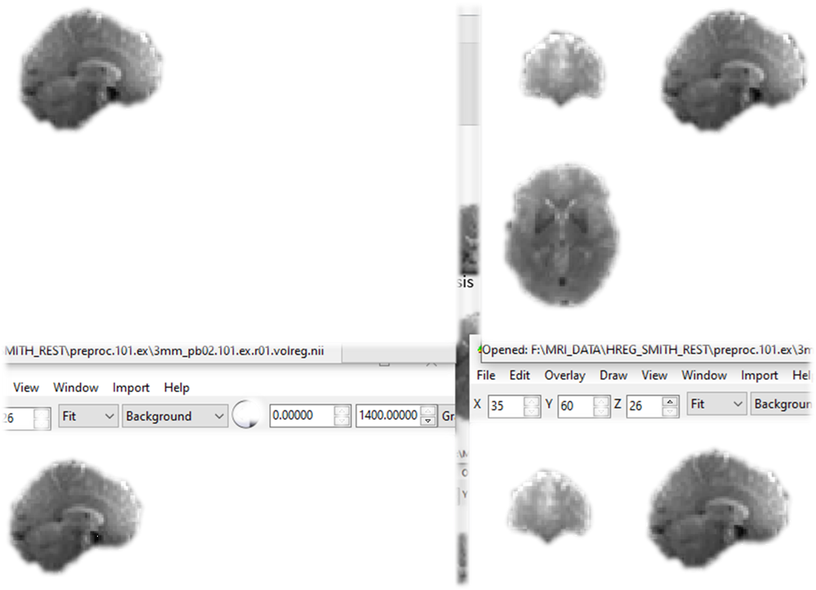
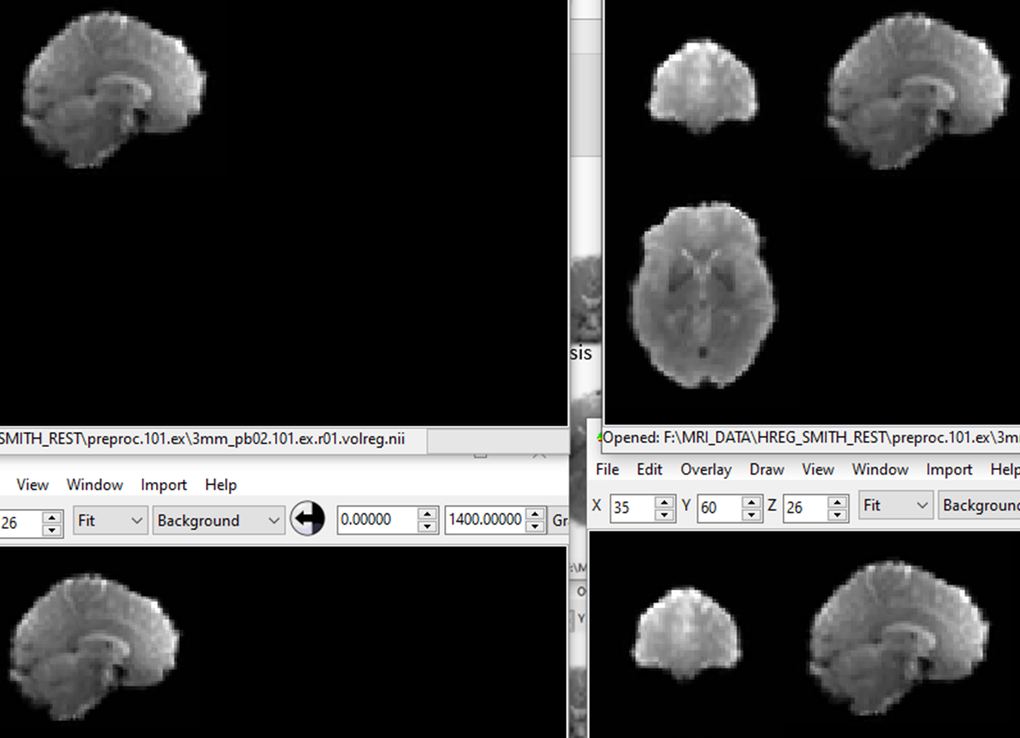
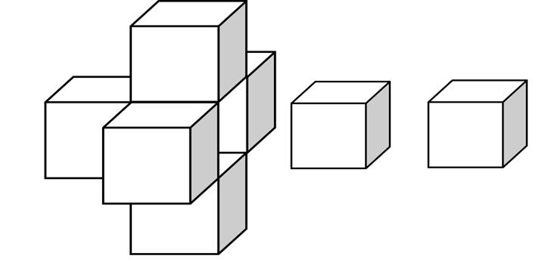





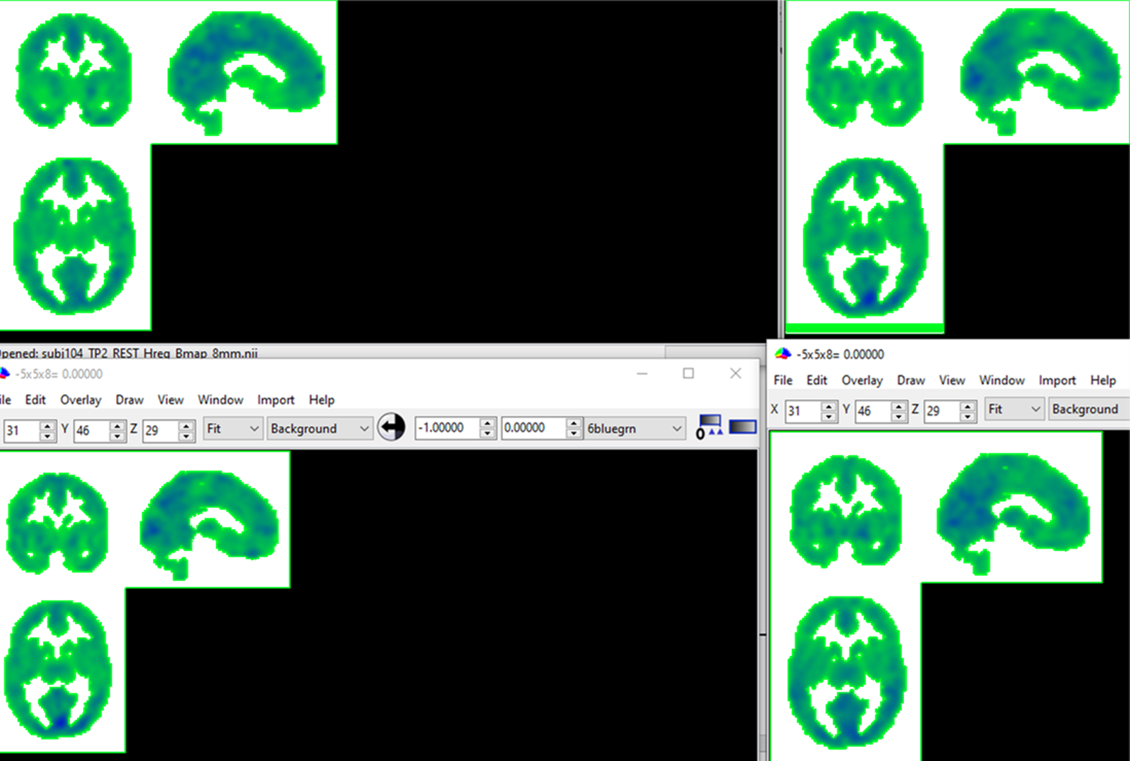
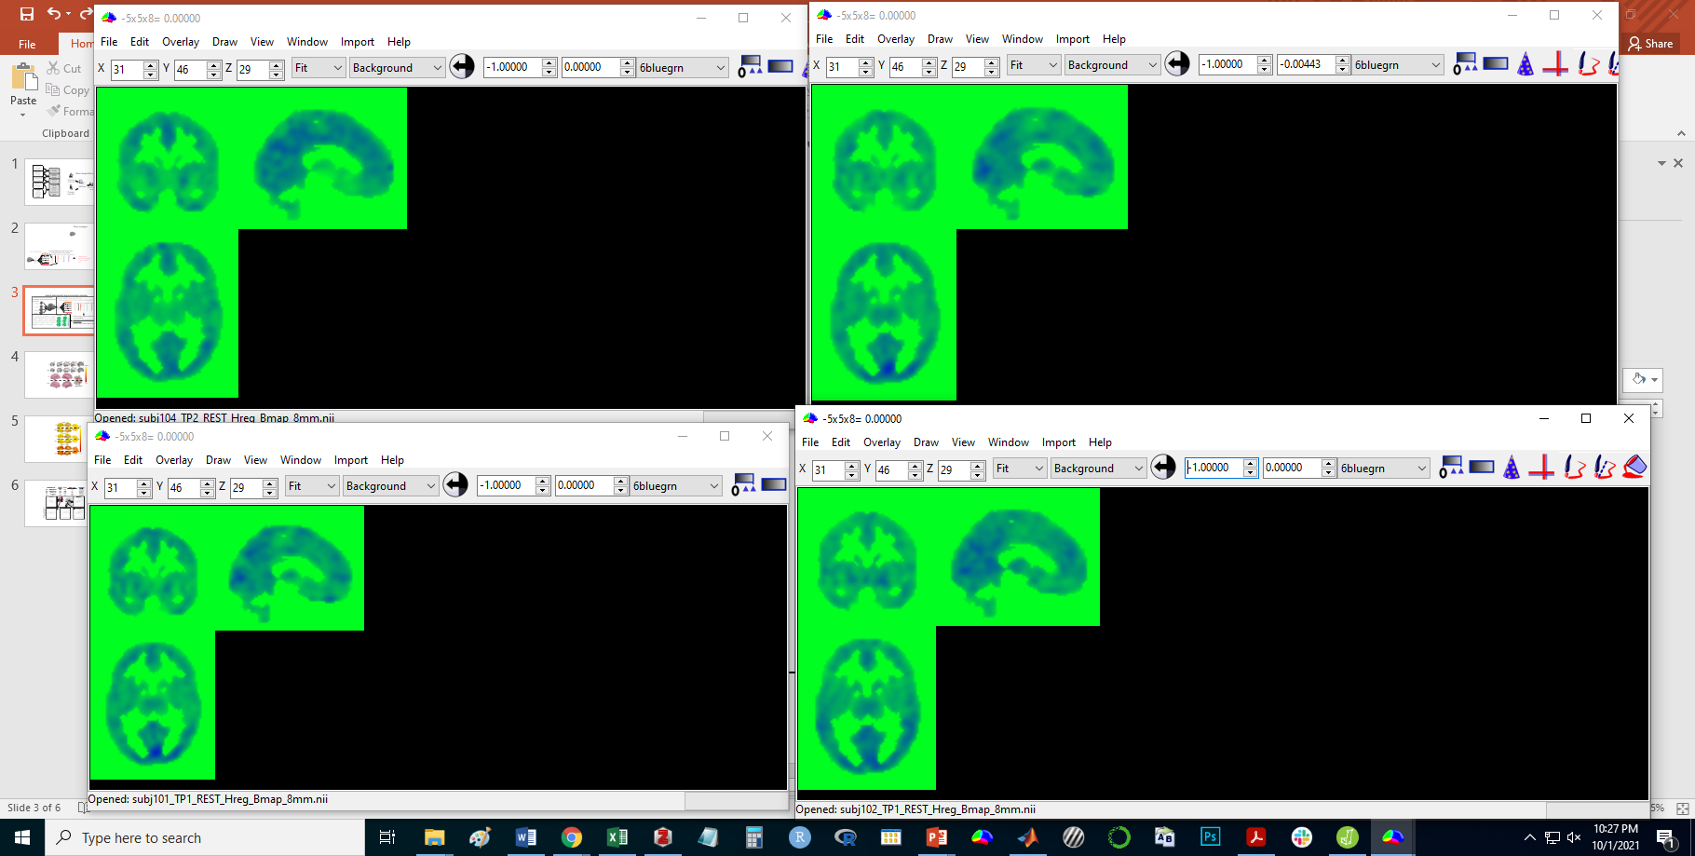
General Heterogeneity Regression (Hreg) Analysis Summary
(1) Concatenate functional runs
(2) Search Light (SL) Analysis at each voxel
Regression for each voxel pair in the SL (example below)
1. Flanker
…
…
Y1 = B0 + Y2B + xB + NB + (Y2*N)Bi + e
2. IAPS
…
…
3. Resting
…
…
…
…
…
…
…
4. FNT
…
(3) Paired T-test comparing the General-Hreg maps from the Exercise condition to the Rest condition
Exercise - Rest
General-Hreg
General-Hreg = mean of pairwise Y2 Bs in SL, multiplied by -1.
General-Hreg is put in center voxel of each SL.
0
-1
…
…

Slide 3
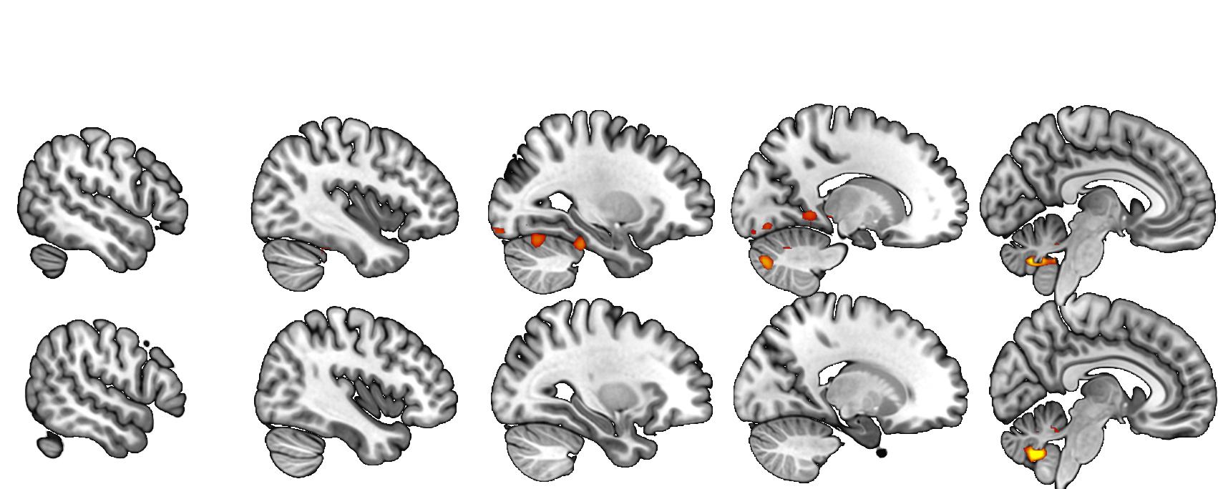
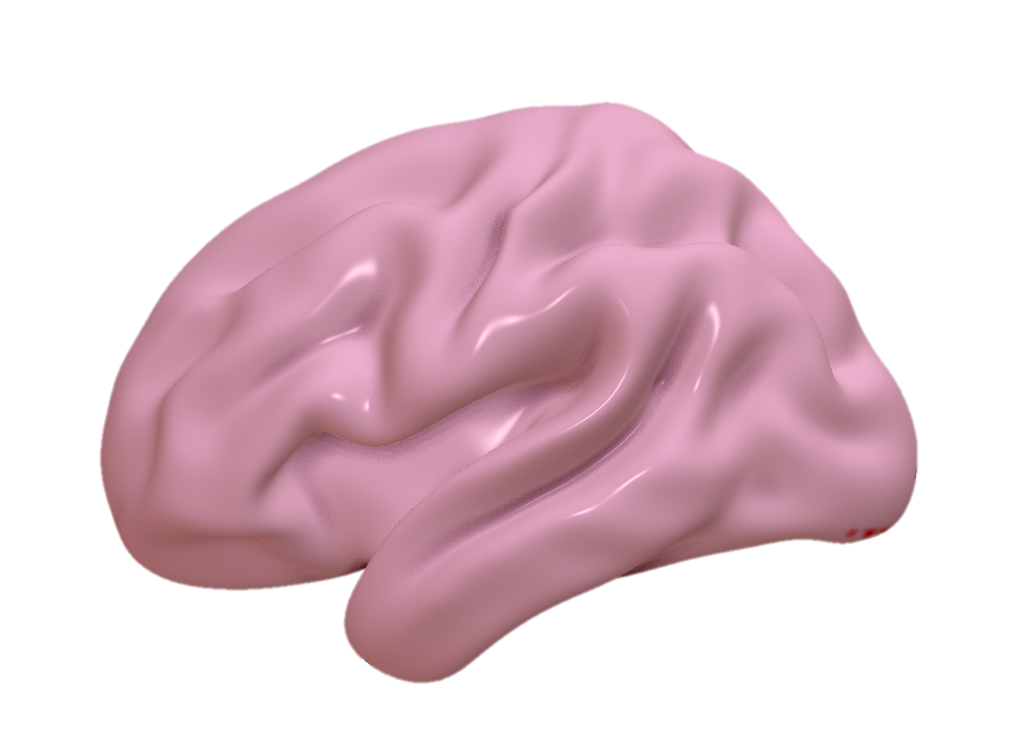
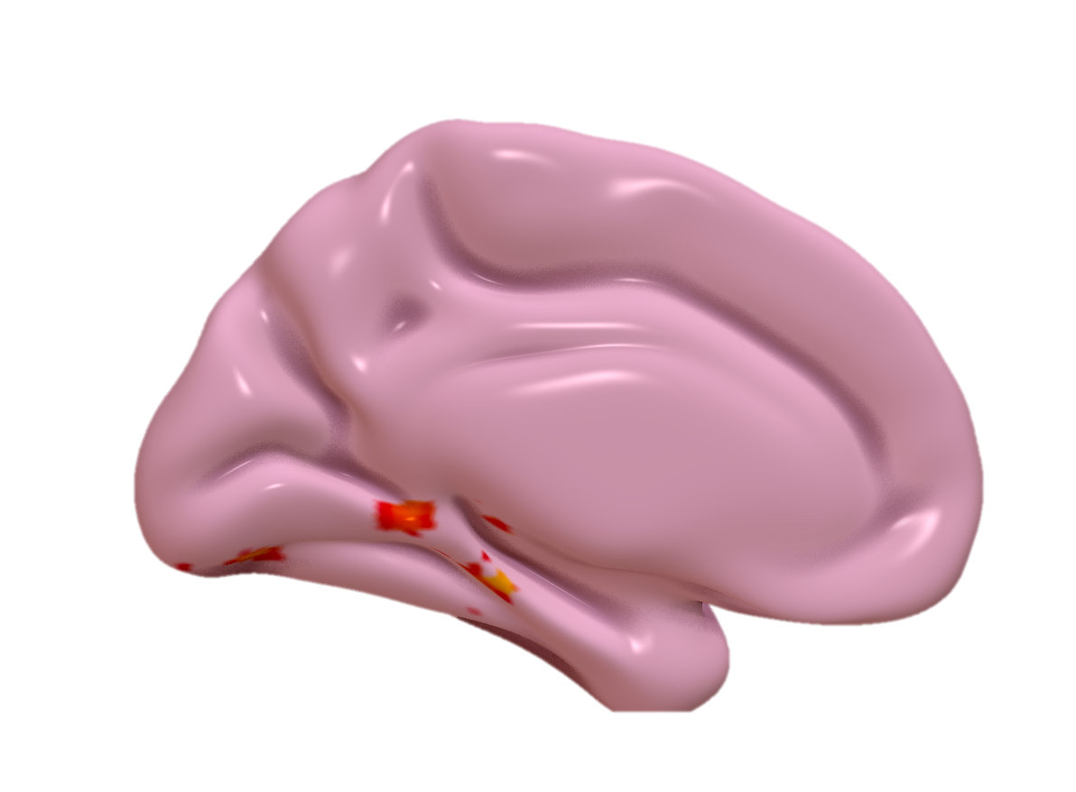
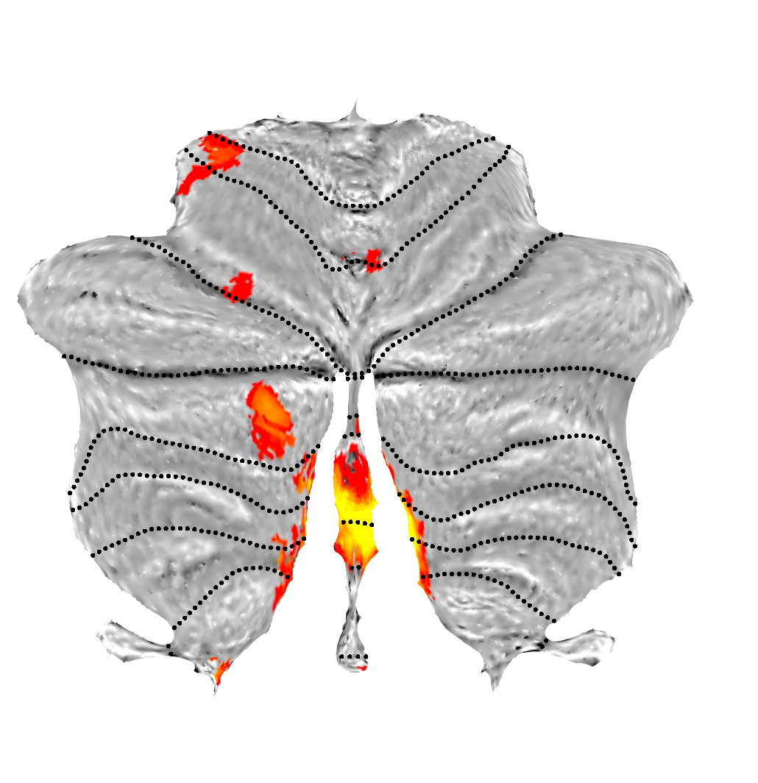
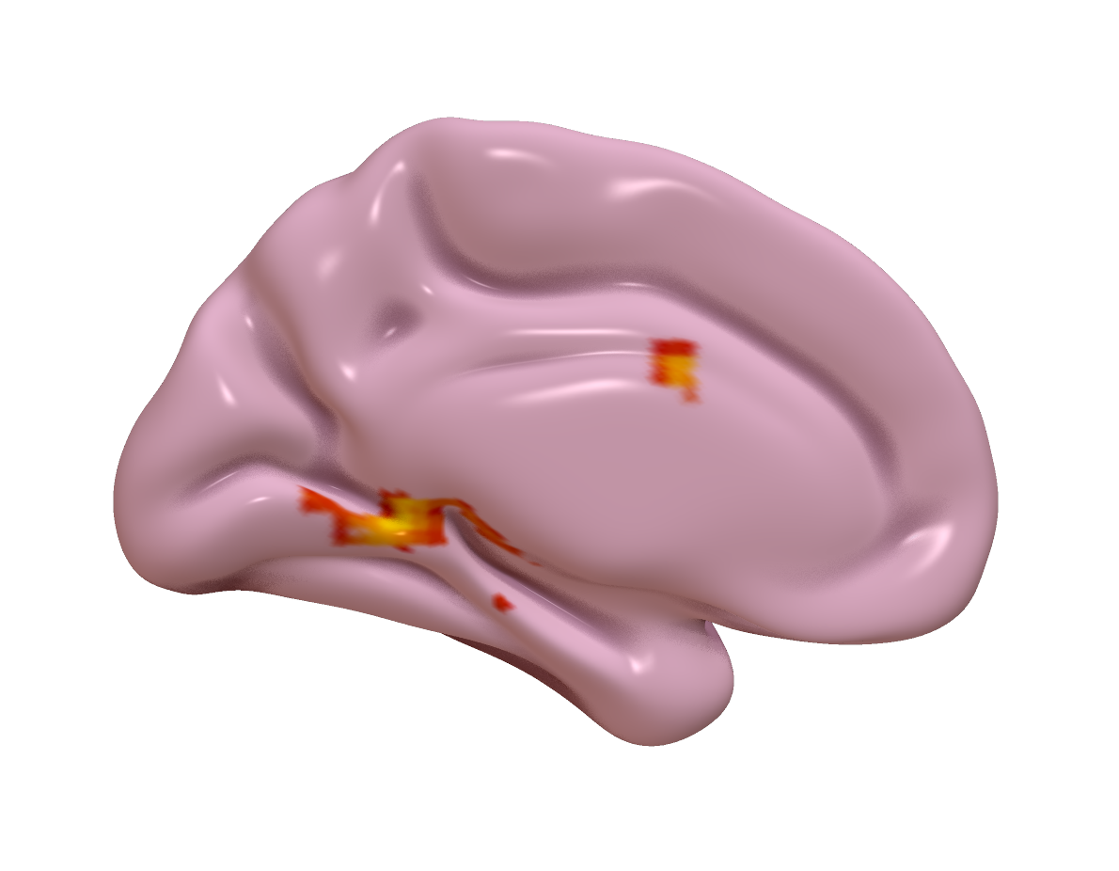
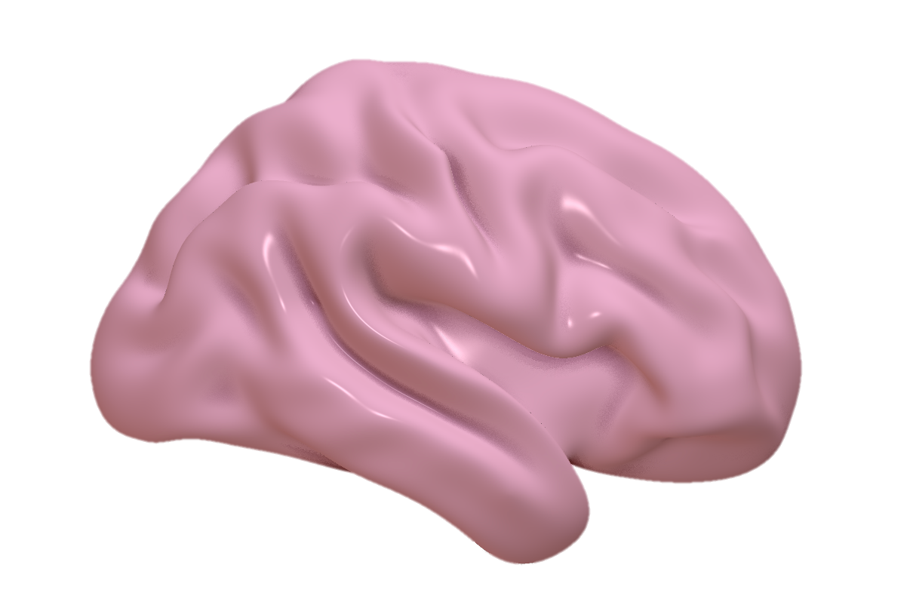
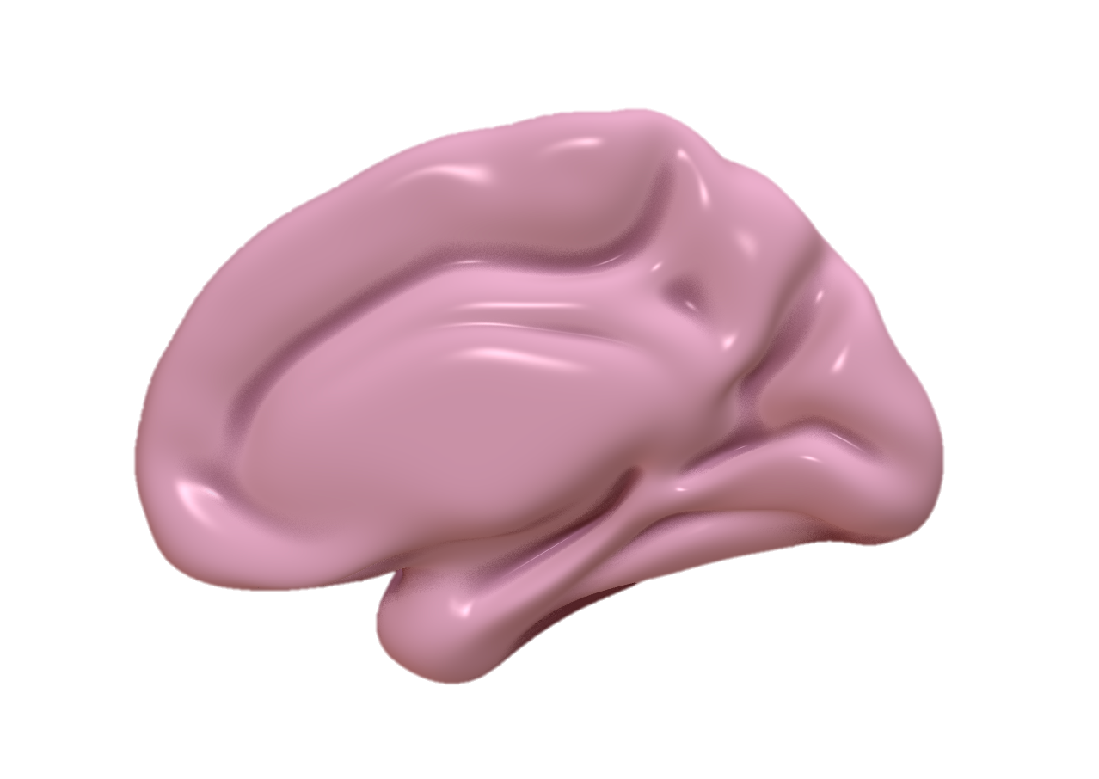
New Data
-52
-40
-28
-16
-6
Left
Z-Value
2.4
54
42
30
18
6
Right
Left
Right
1.96
Notes:
Slide 3 with new data
Notes:
- Surface projection from .001 to 2.6 to make data more clear

Slide 4
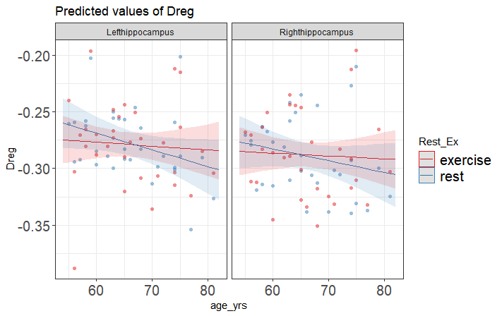
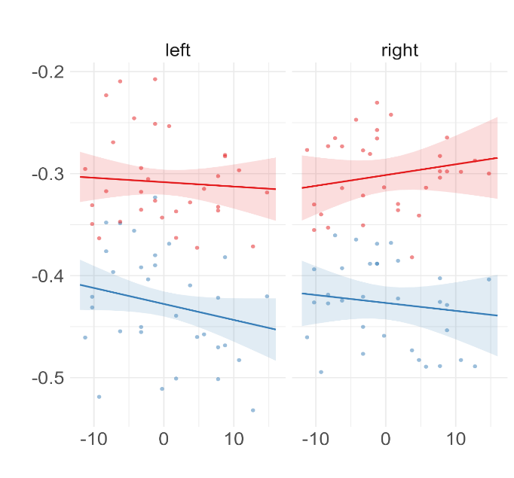
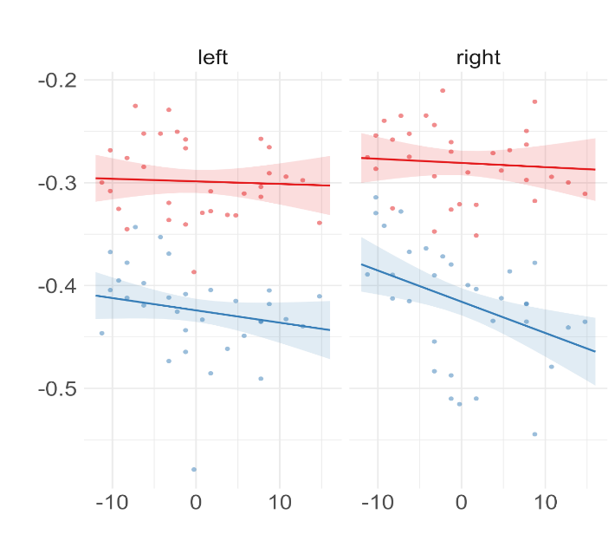
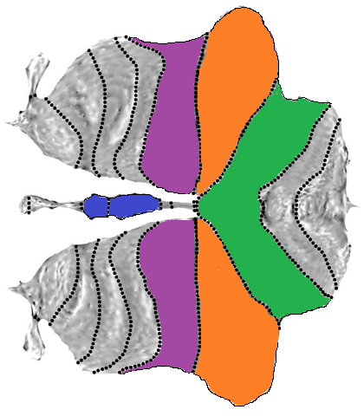
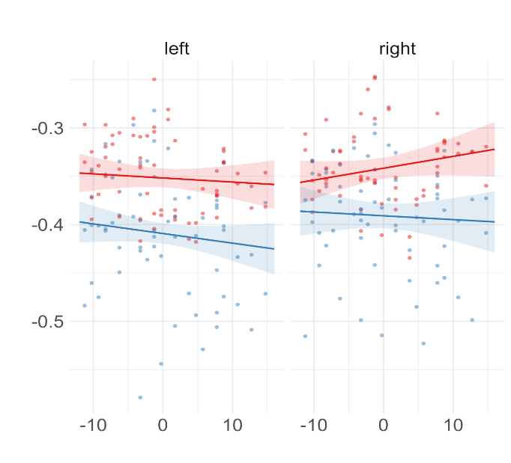
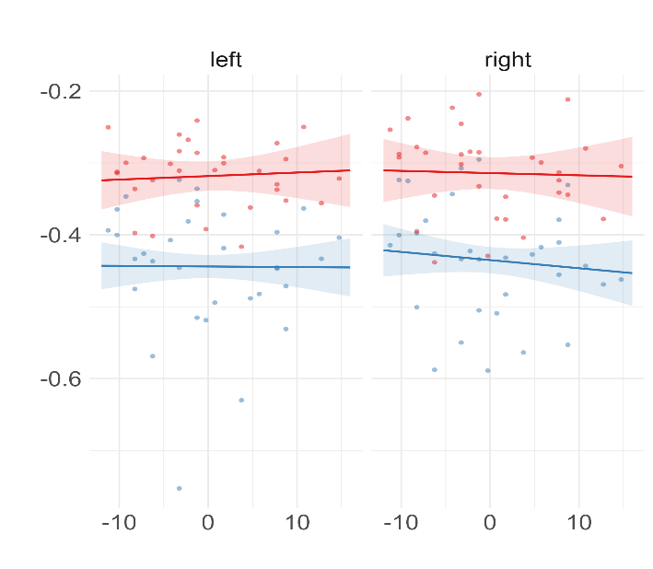
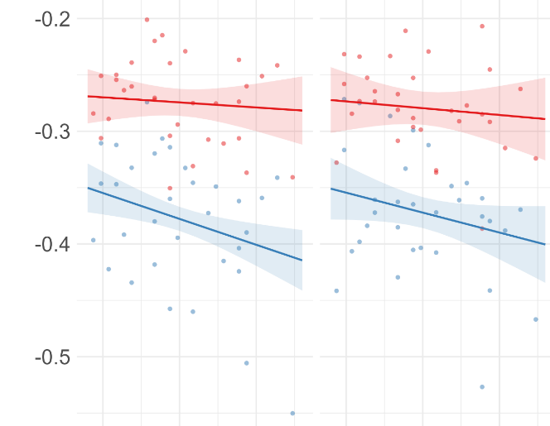
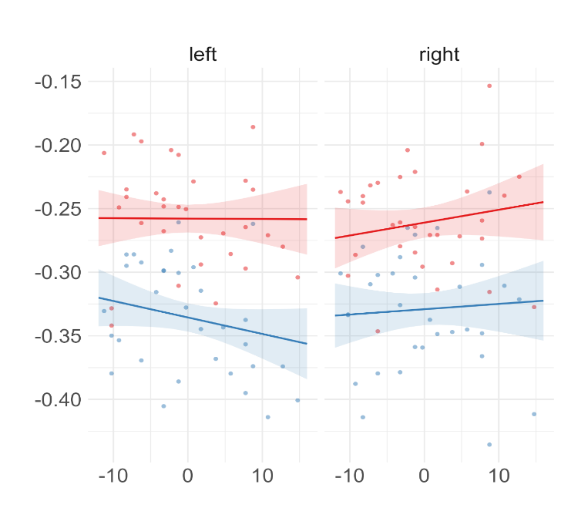
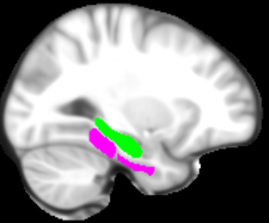
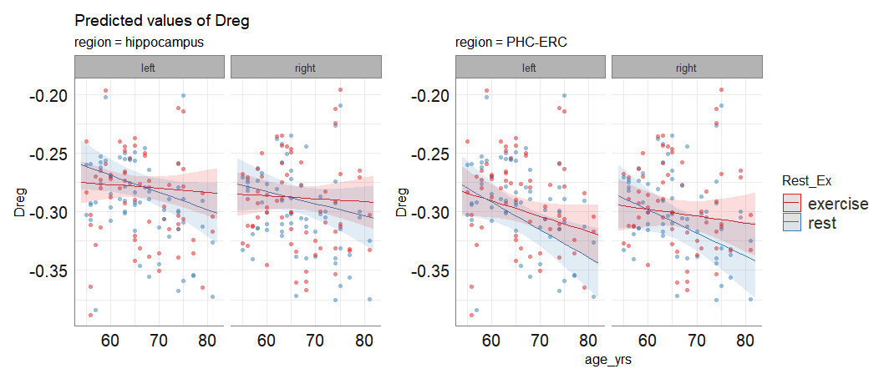
Left
Right
Left
Right
Crus 1
p=0.039 * ; p=0.356
Crus 2
p=0.042*; p=0.0498*
-.2
-.3
-.4
-.5
-.2
-.3
-.4
-.5
General-Hreg
Lobule 6
p=0.115; p=448
-.2
-.4
-.6
Vermis
p=0.612; p=0.867
-.3
-.4
-.5
PHG/EHC
-.2
-.3
-.4
-.5
p=0.051 ˙; p=0.048 *
-.15
-.2
-.25
-.3
-.35
-.4
Hippocampus
p=0.148; p = 0.464
Age in Years

Slide 5
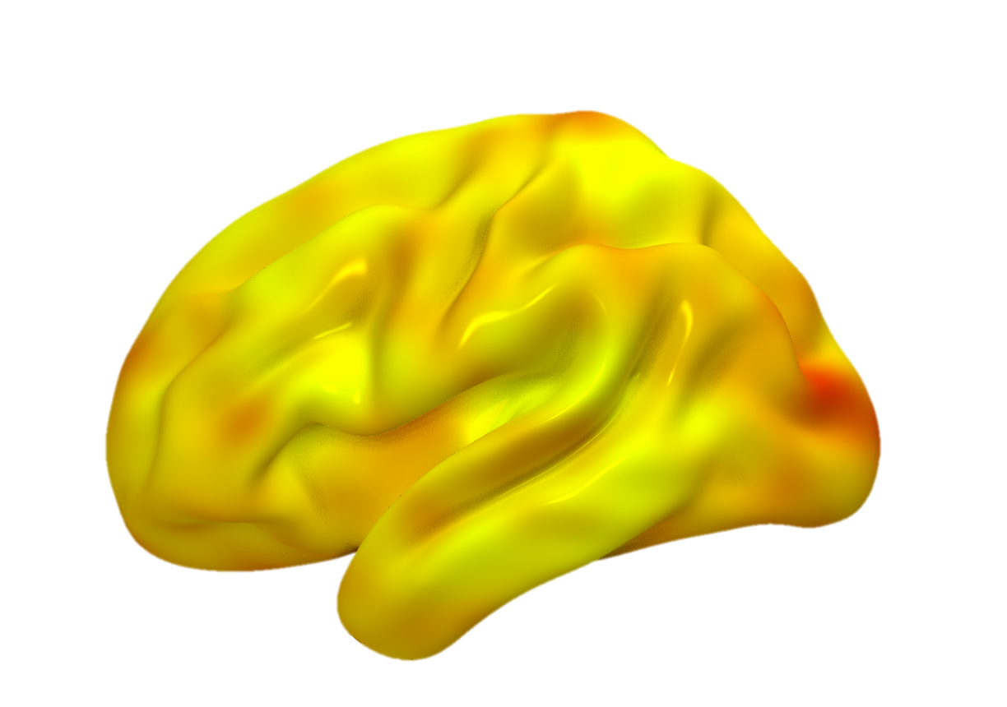
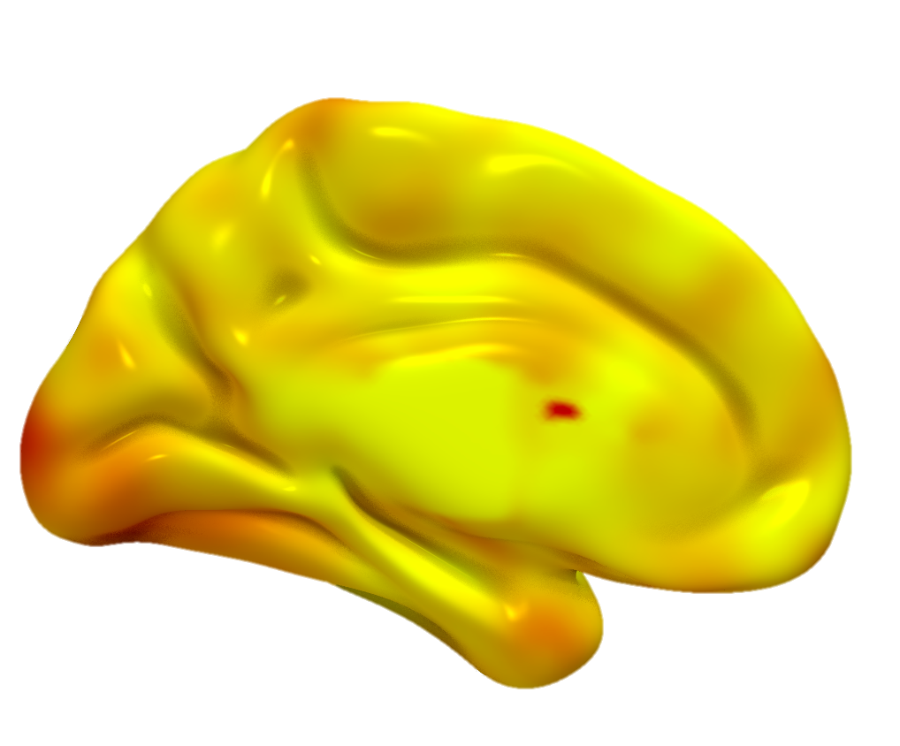
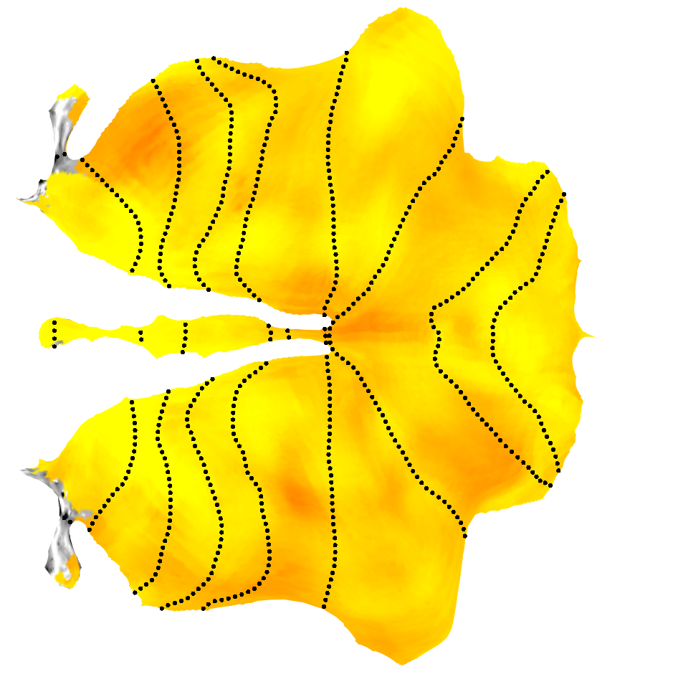
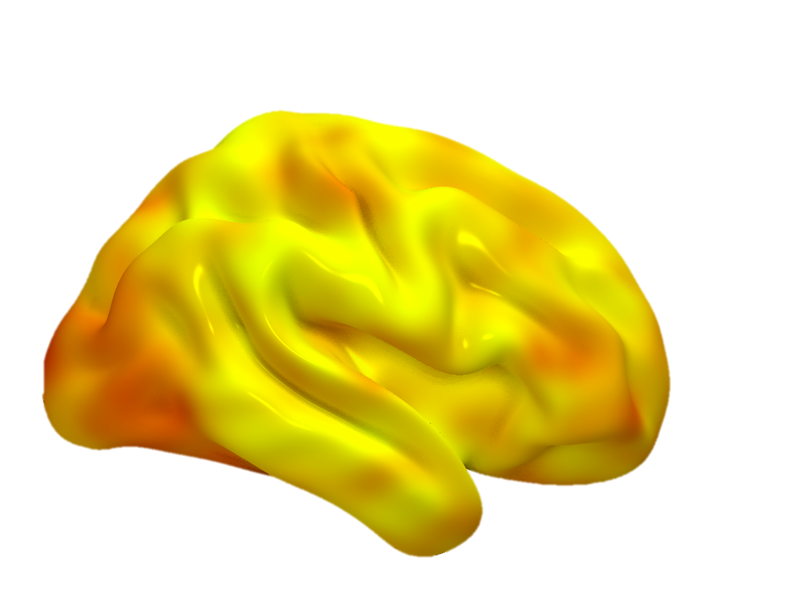
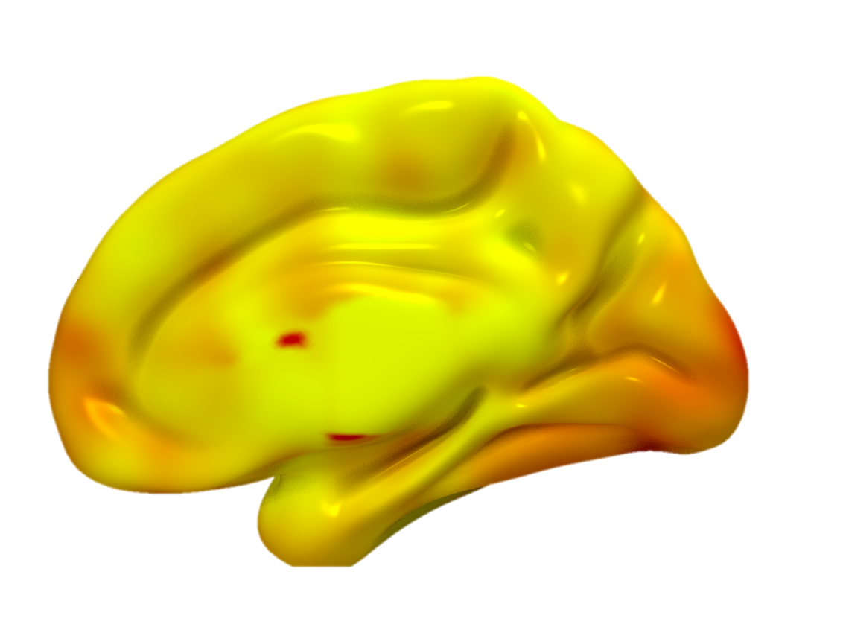
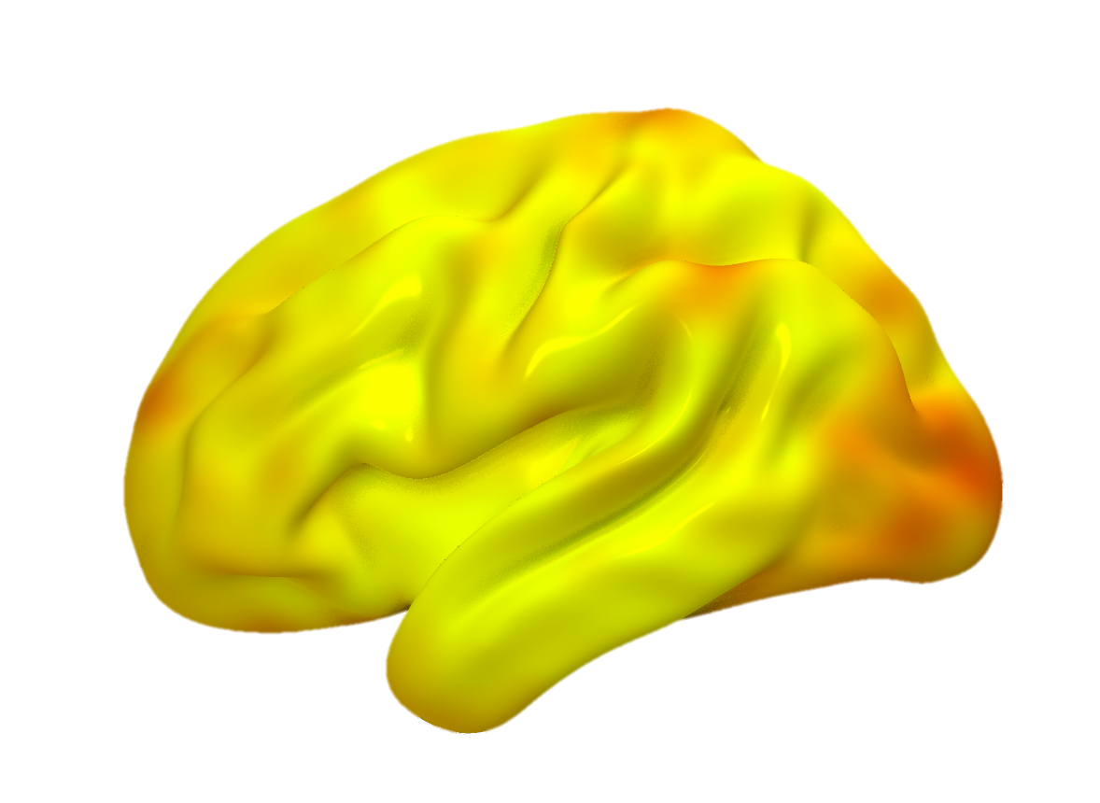
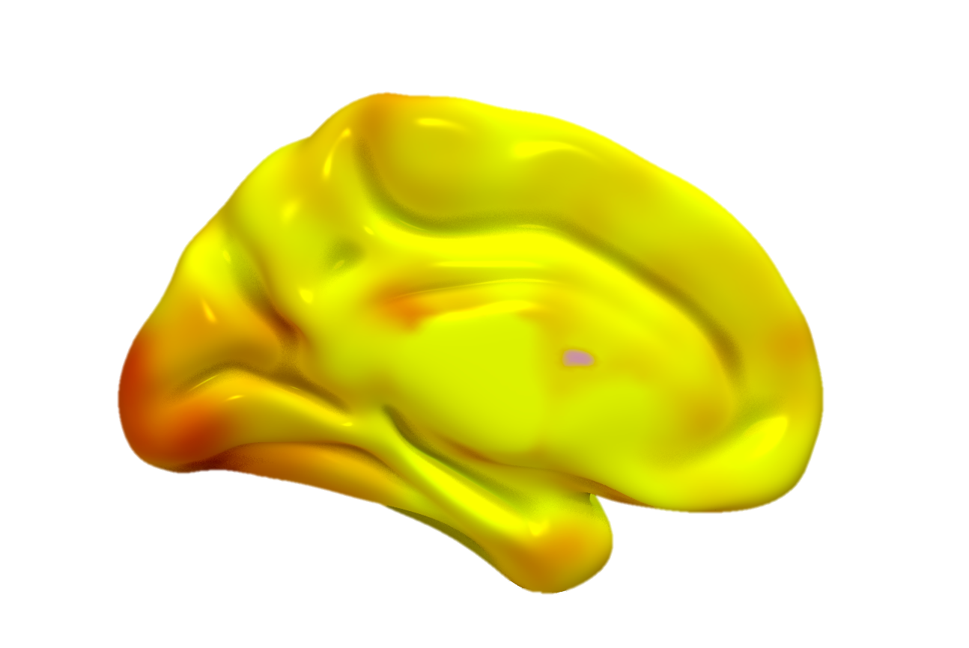
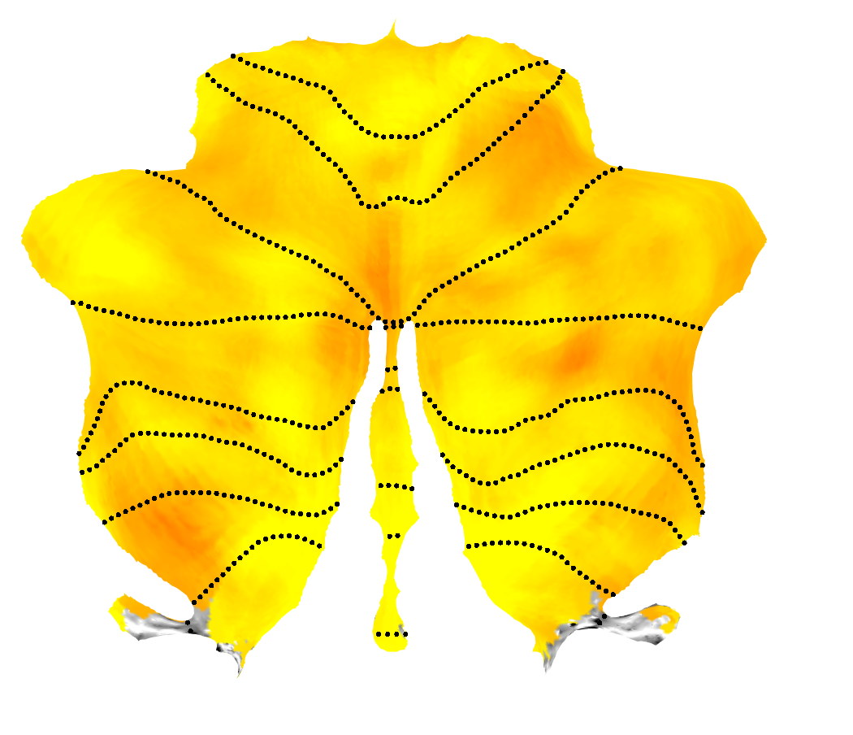
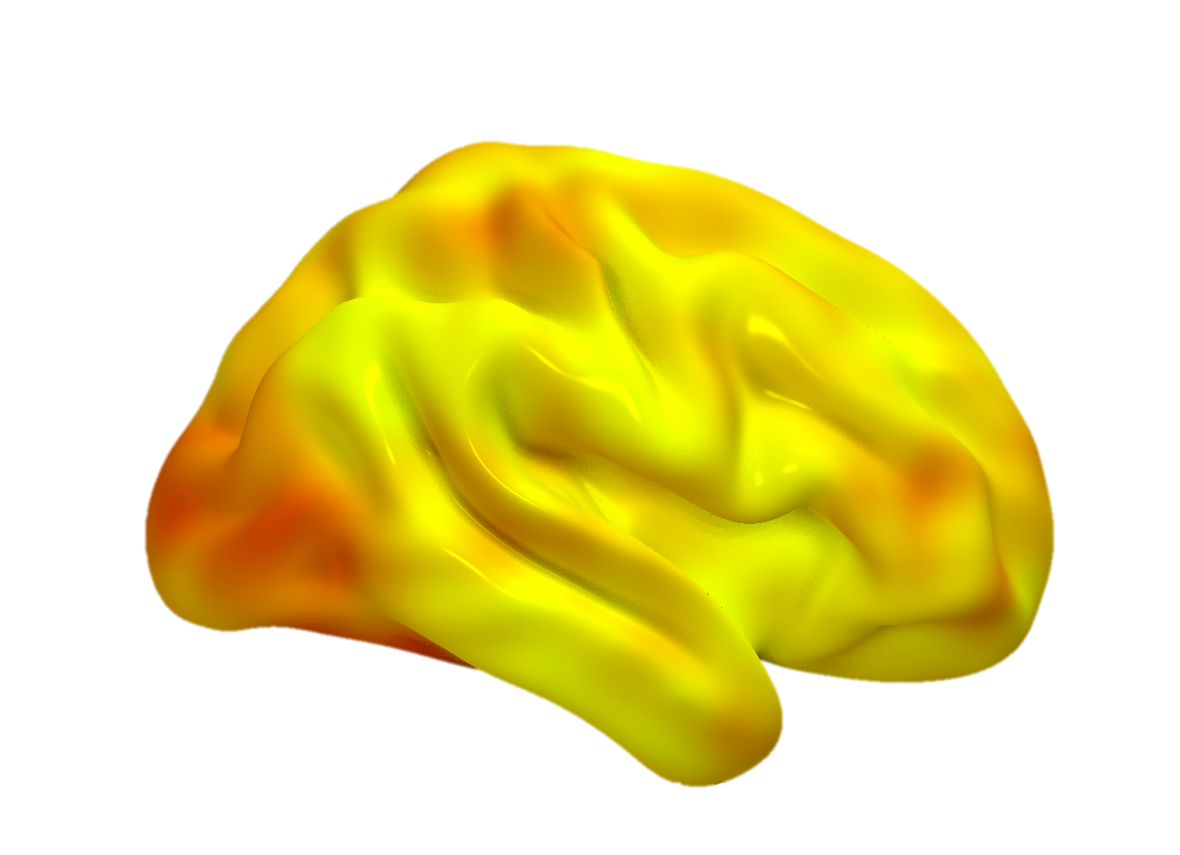
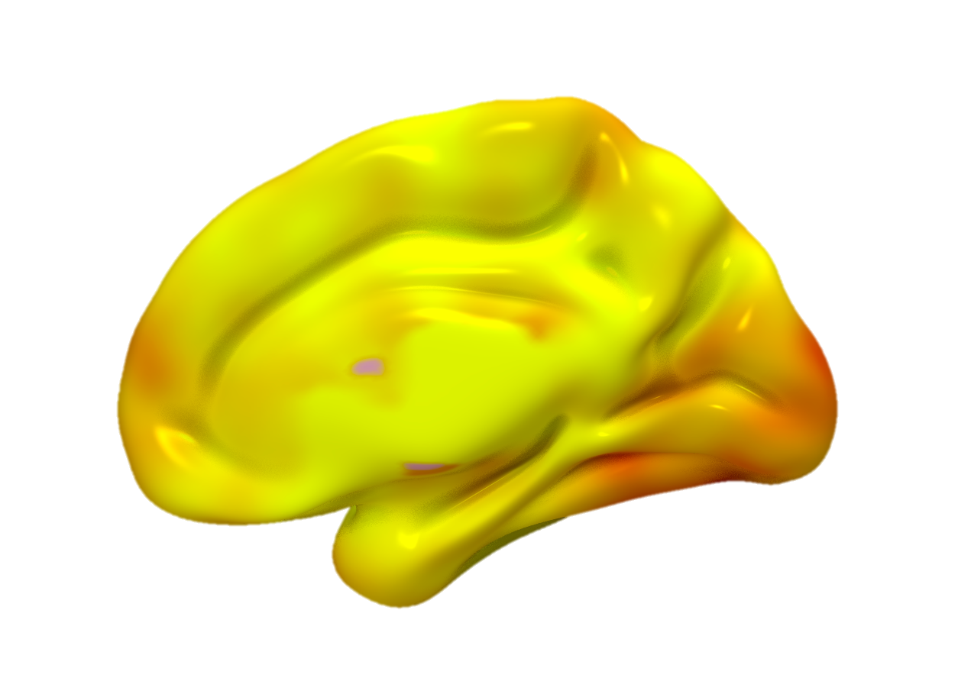
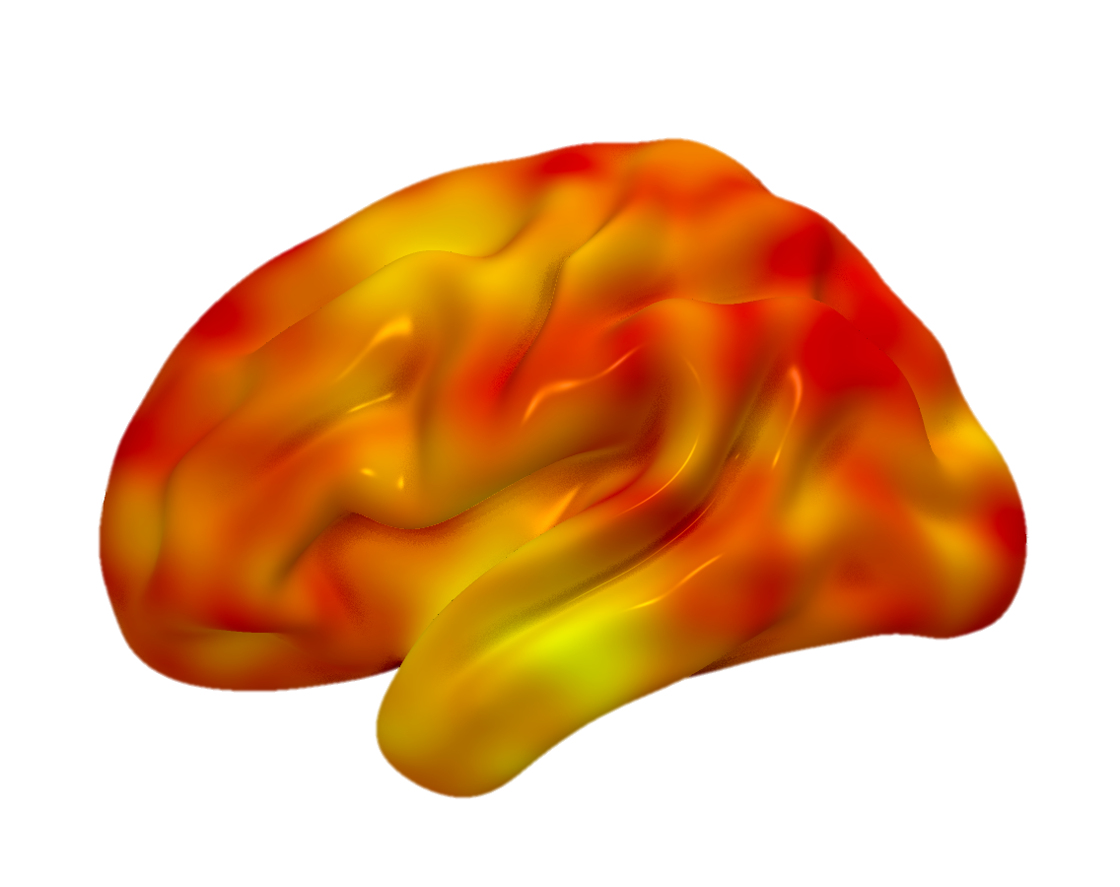
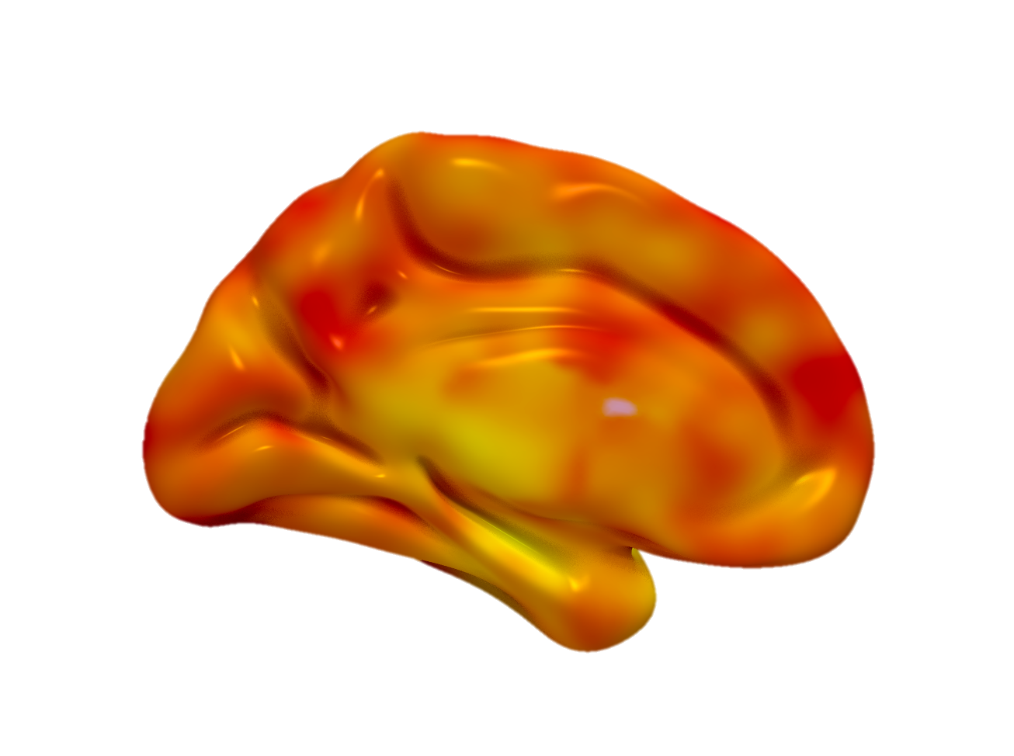
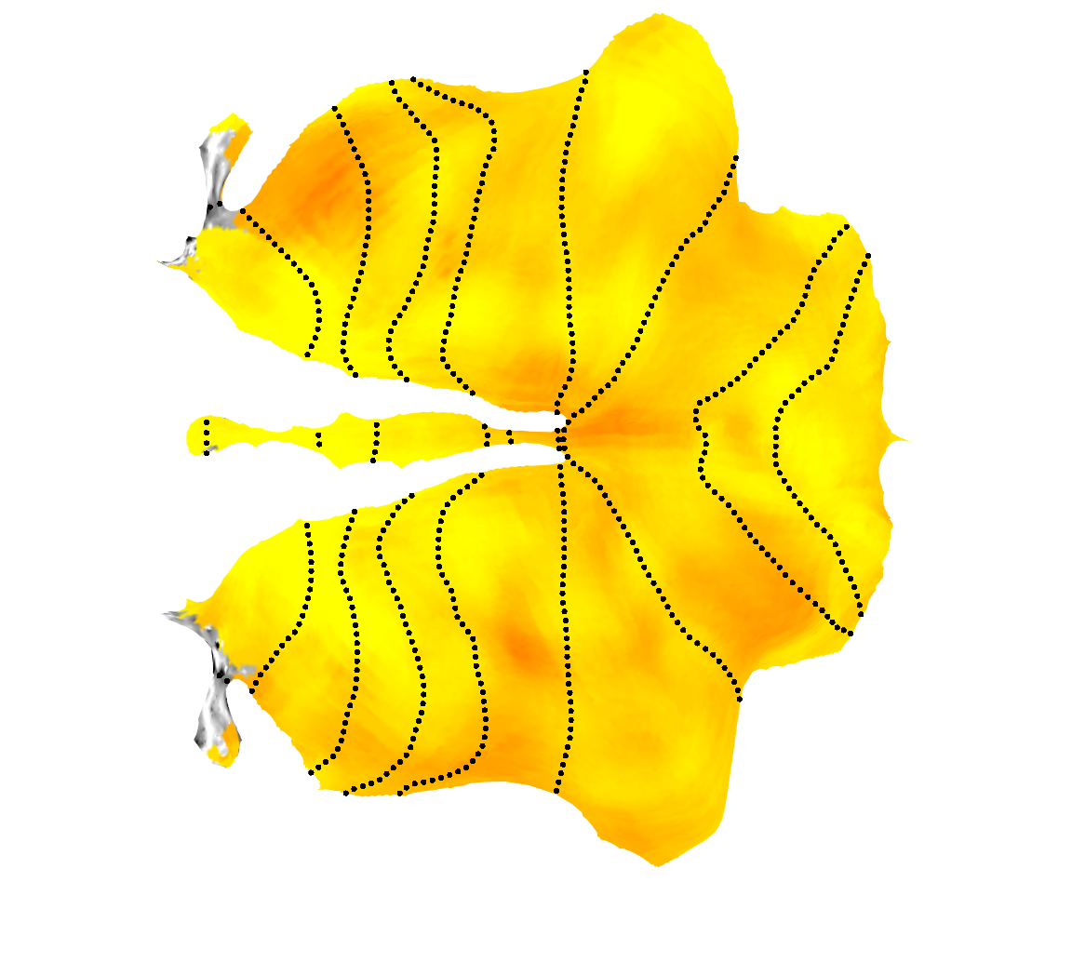
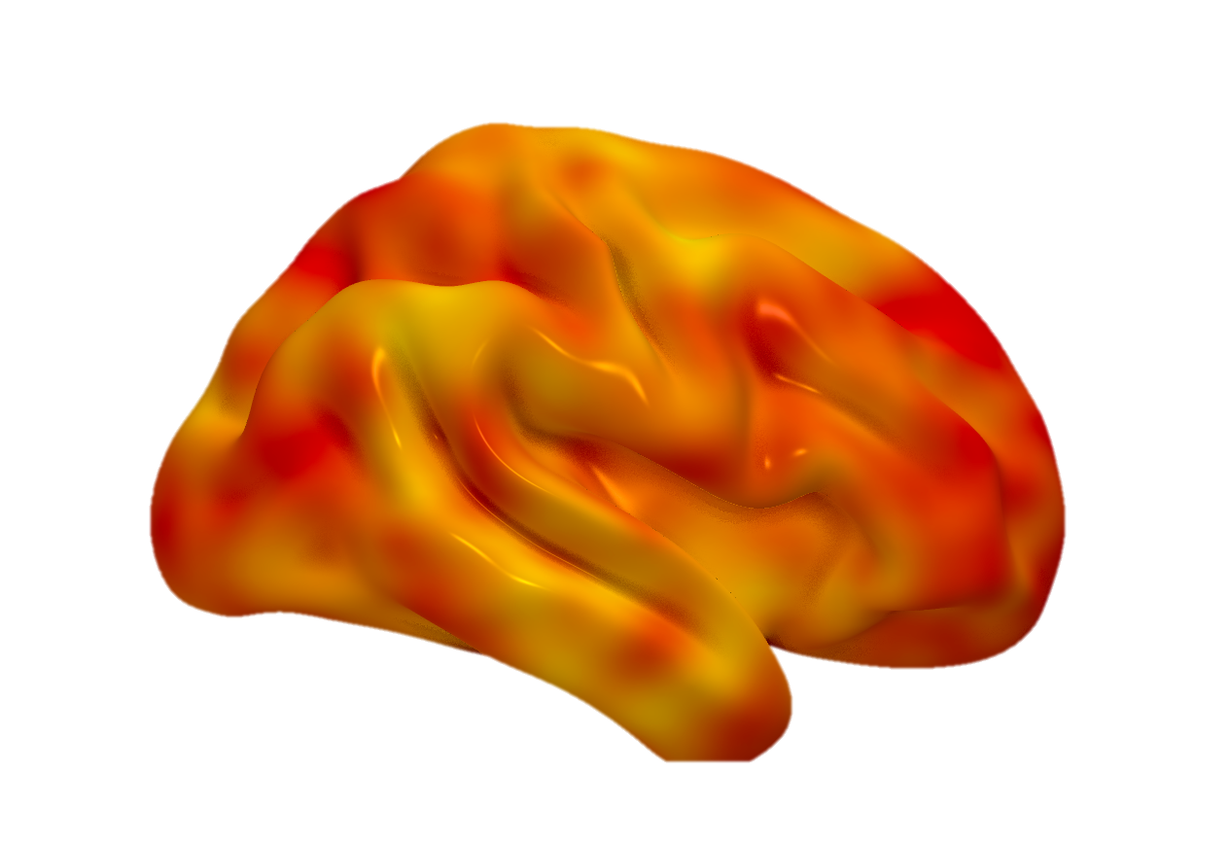
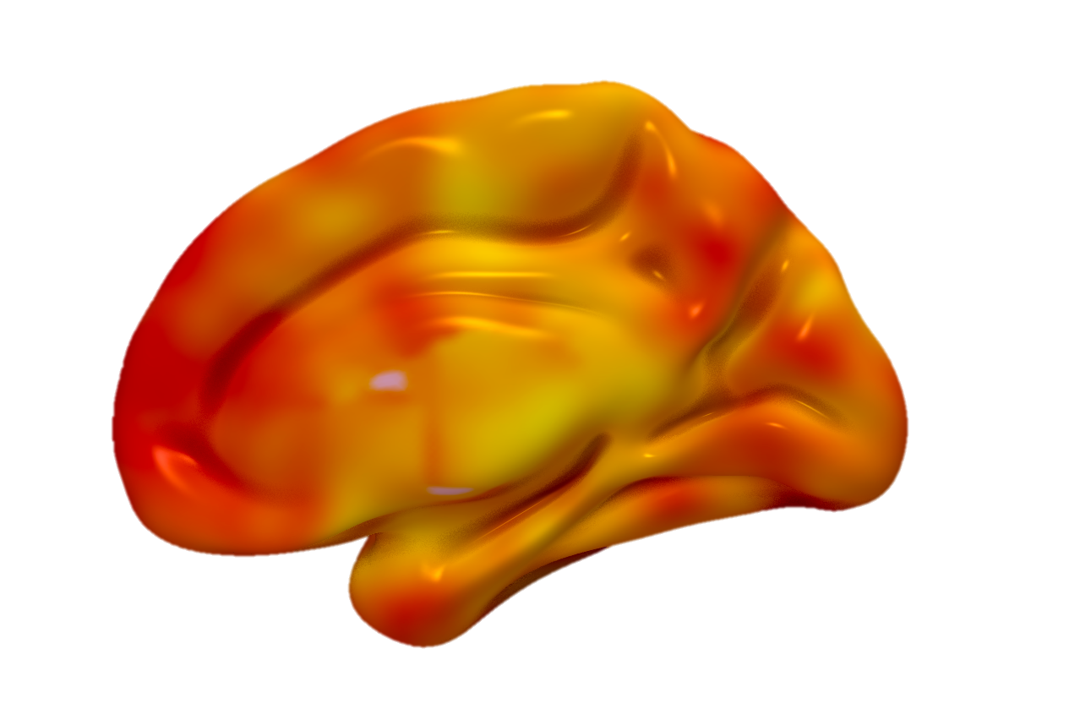
New Data
Rest
Left
ICC
0.8
Right
Exercise
Left
0.4
Right
Exercise - Rest
Left
0
Right
Notes:
New data

Slide 7
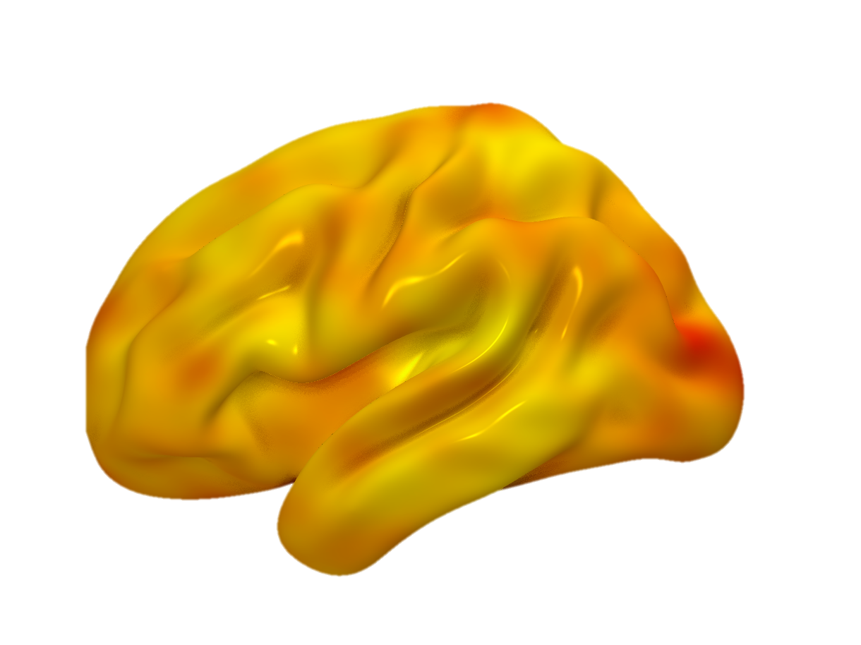
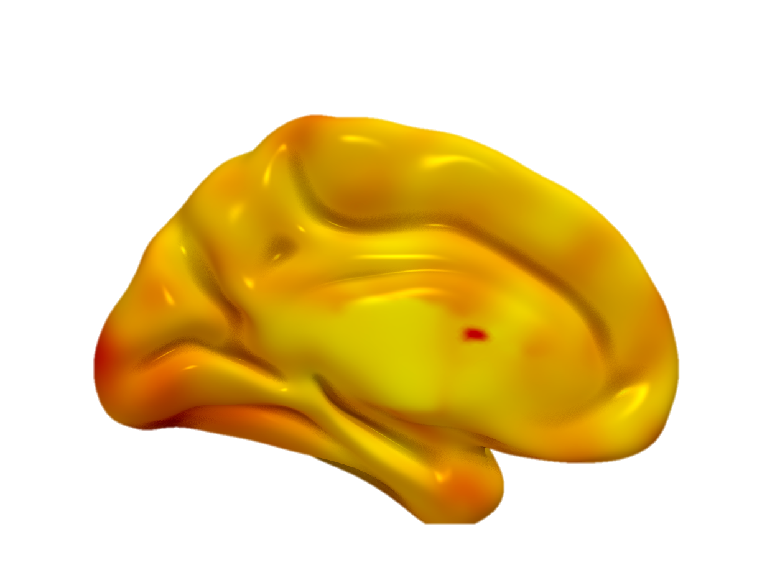
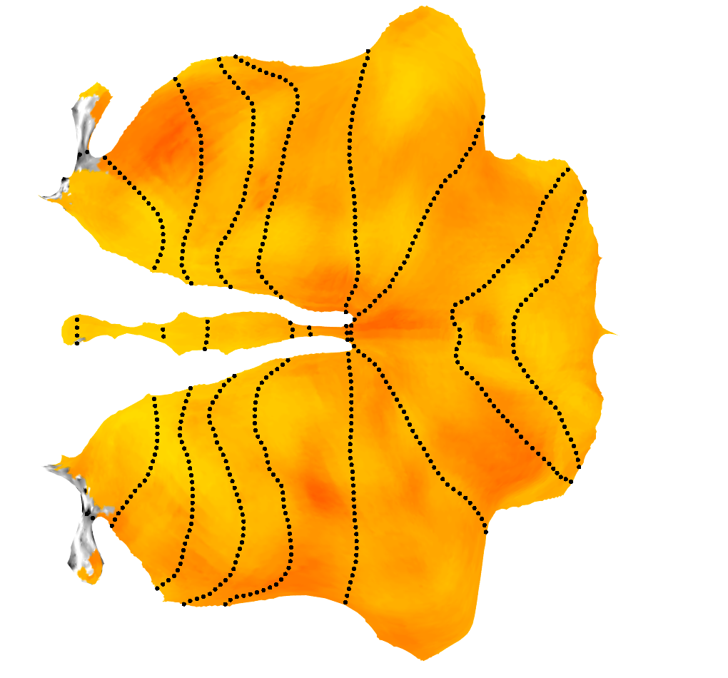
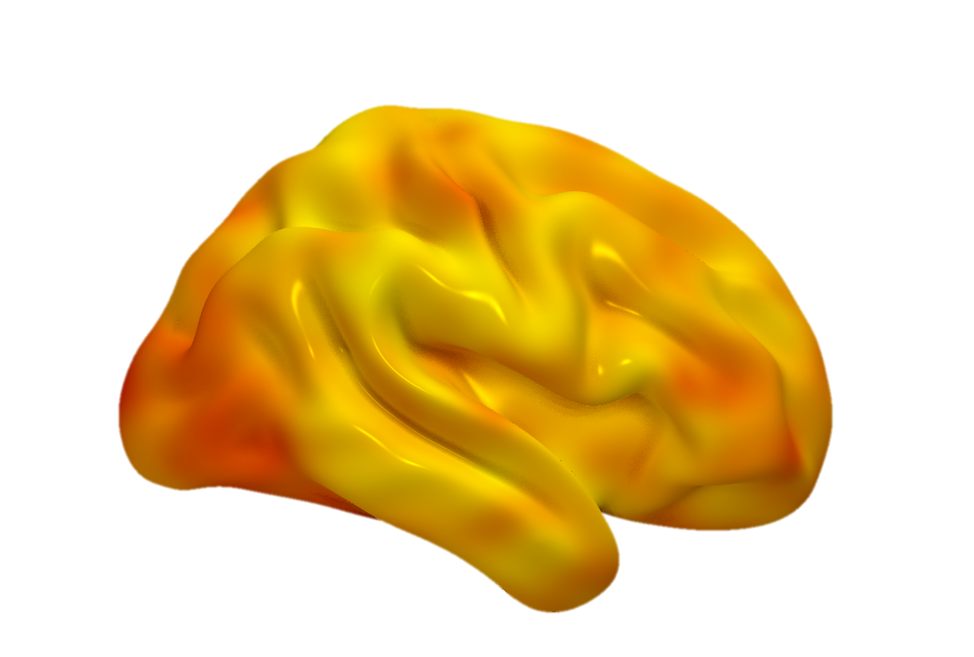
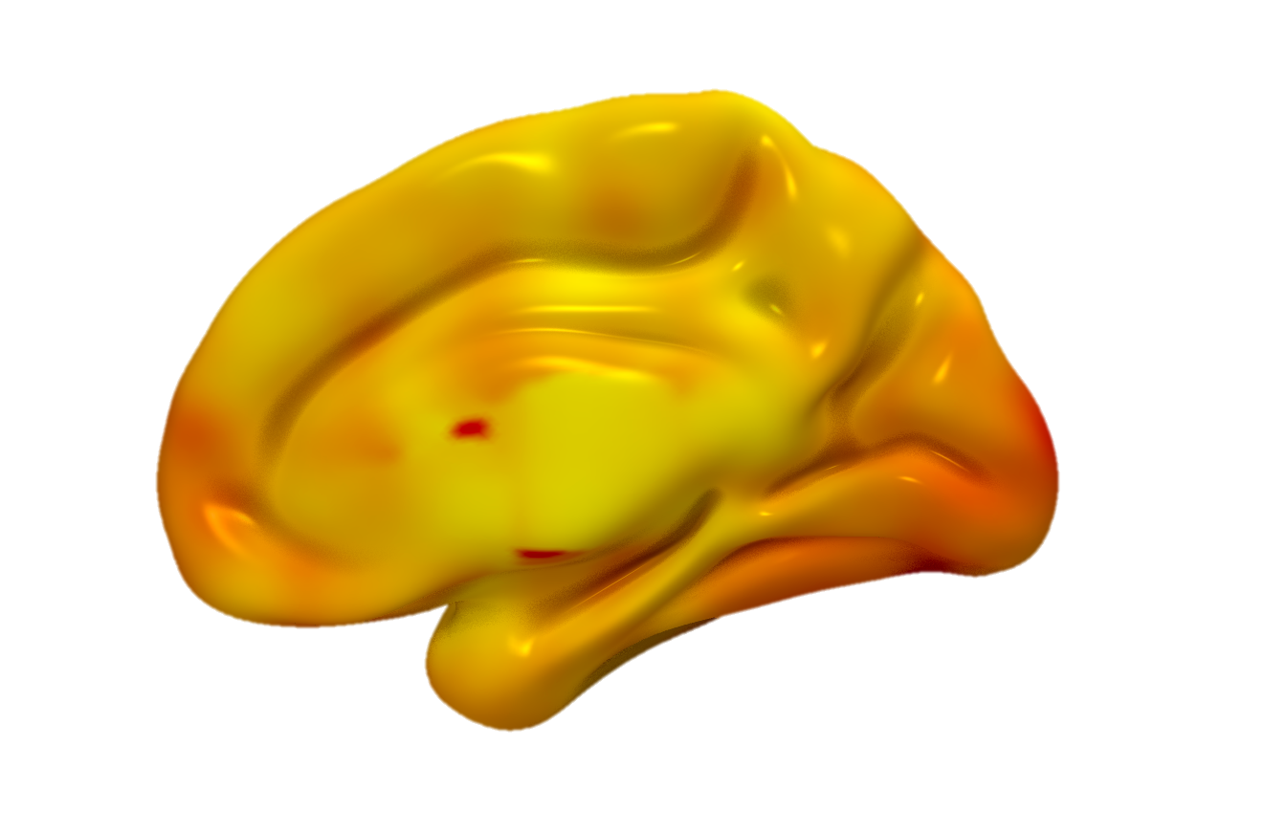
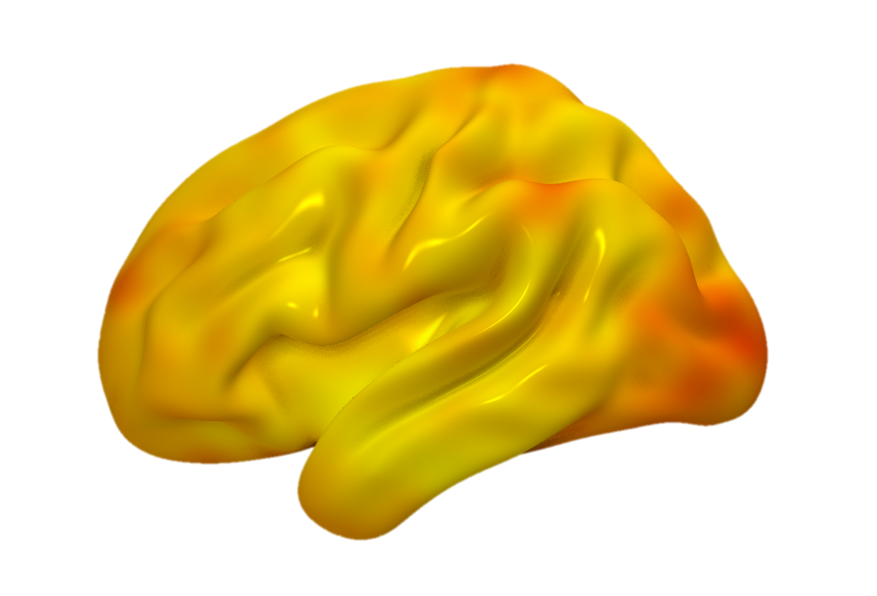
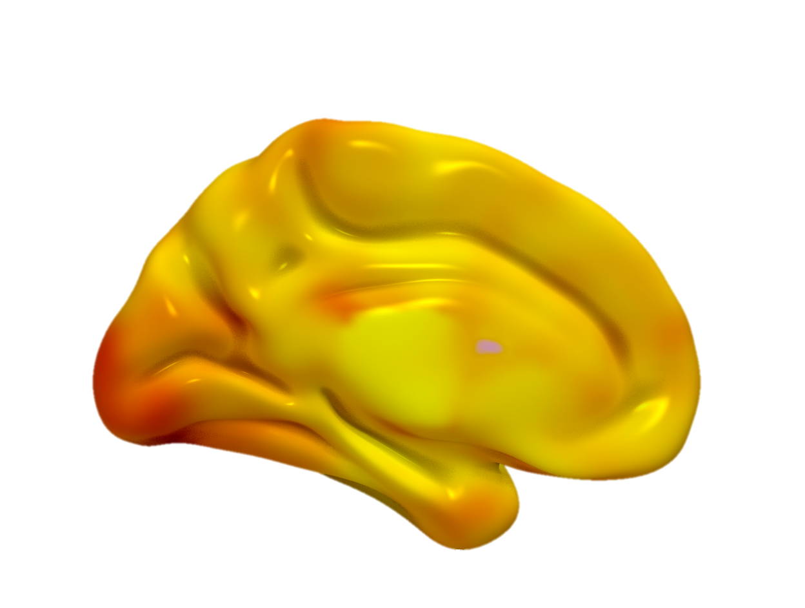
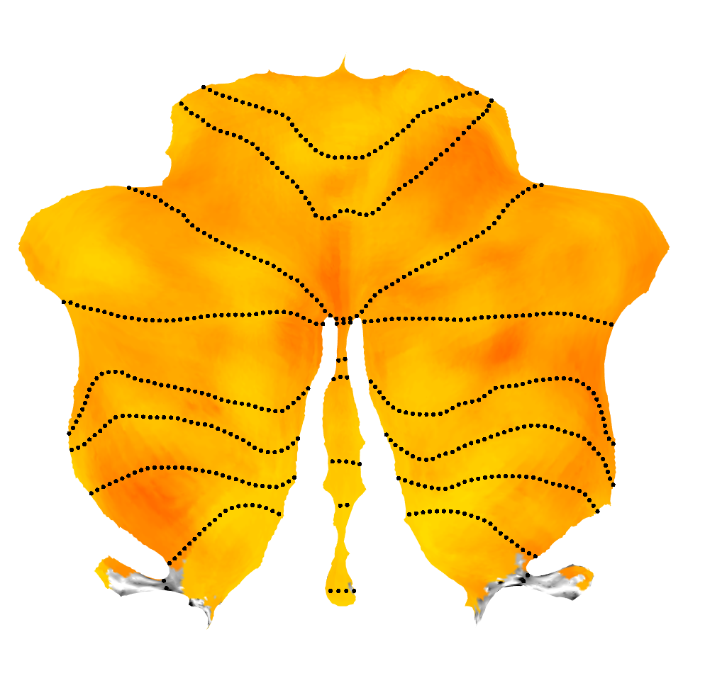
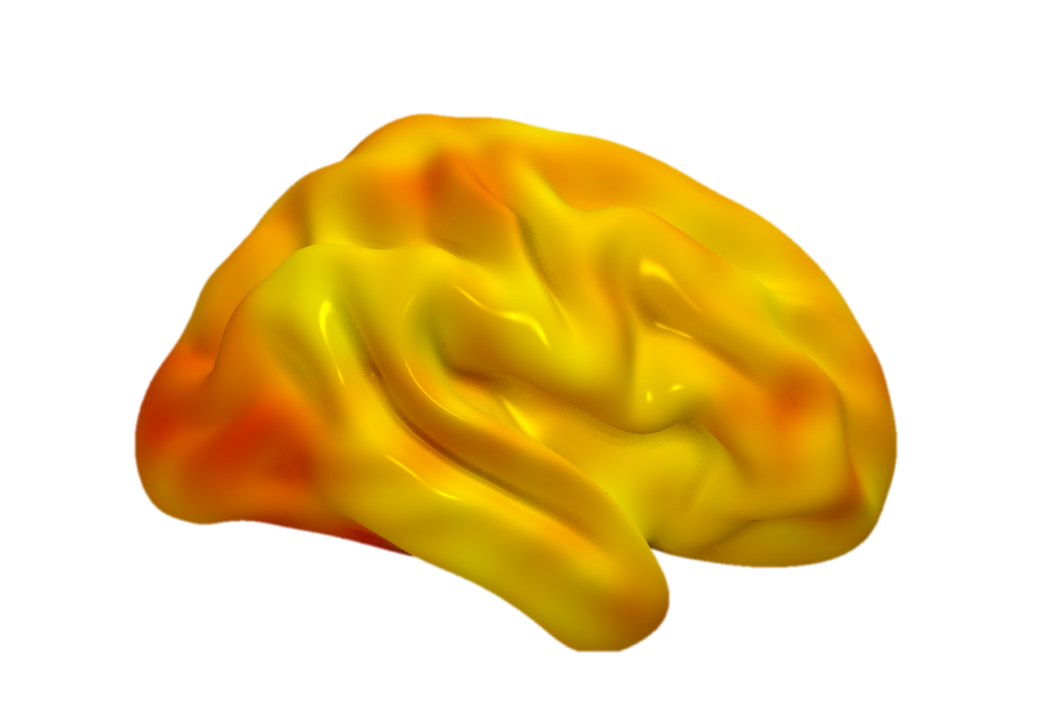
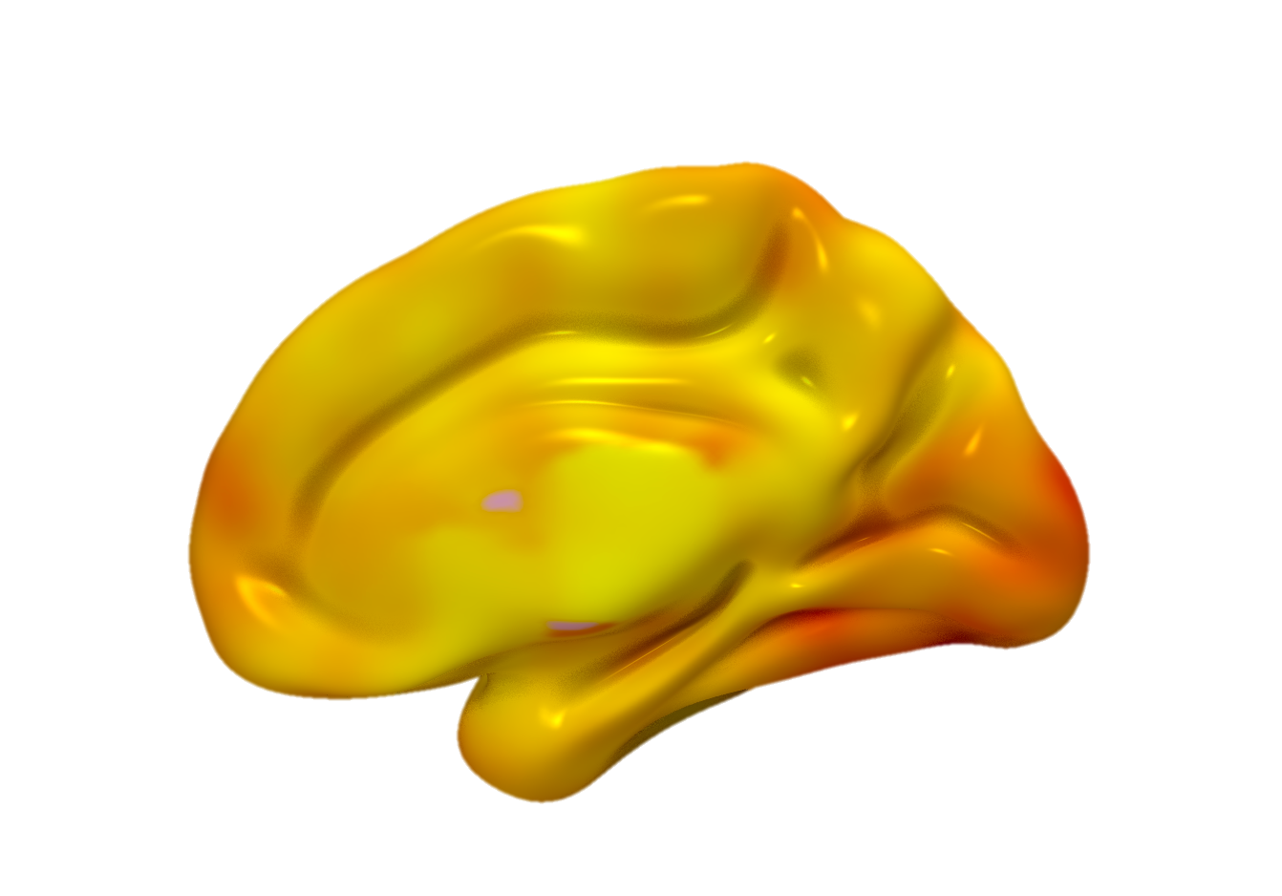
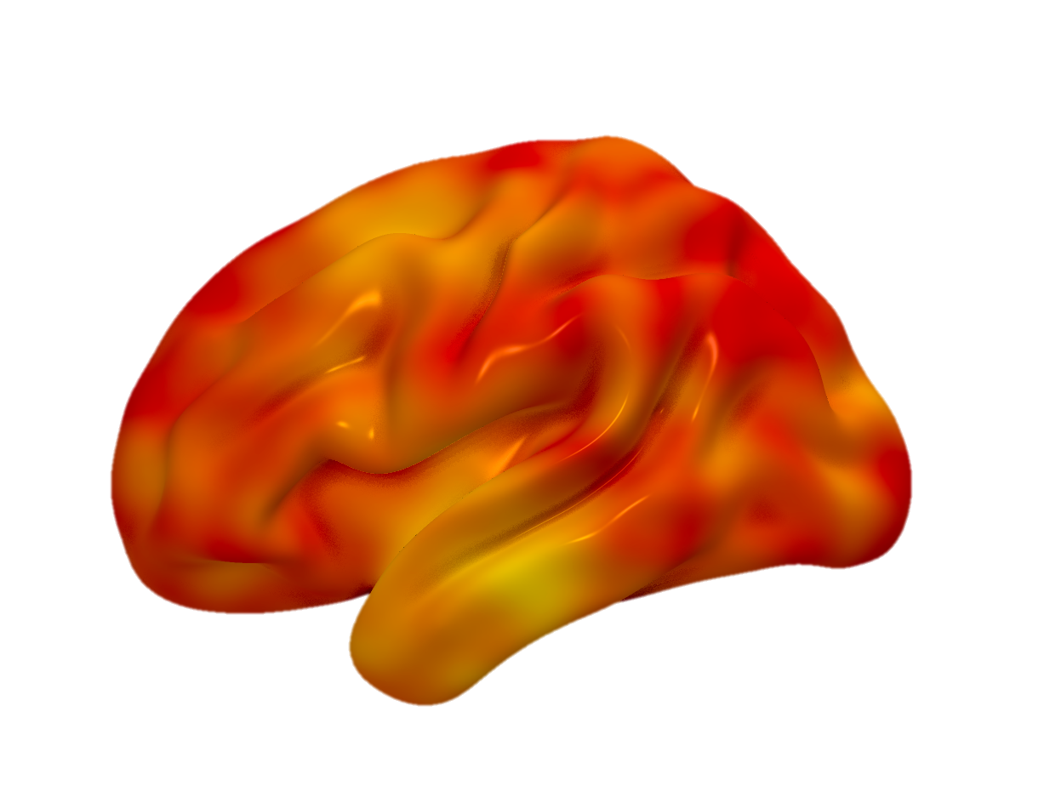
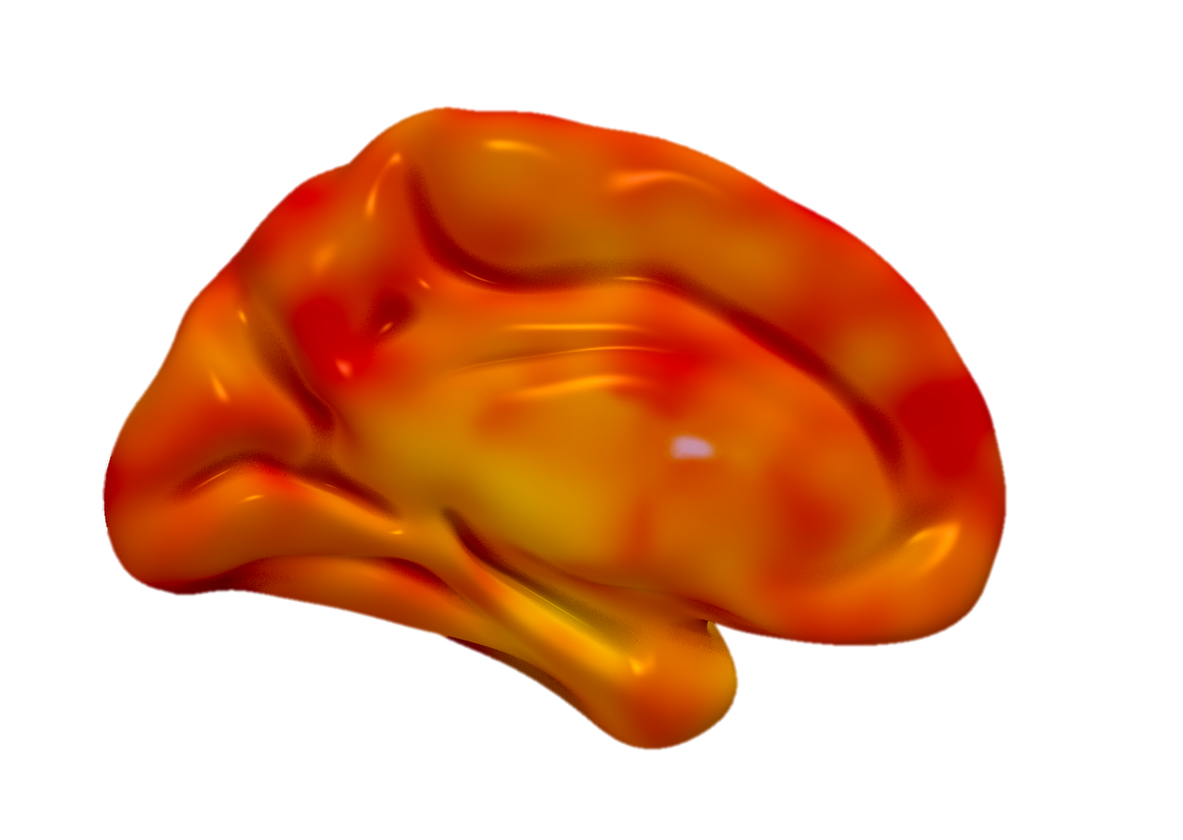



New Data
The last figure was just 0-0.8(for better contrast in the image) so I made new figures of the data for both 1 and 0.8 since they were relatively similar now in contrast and 0-1 could include more data
Rest
Left
ICC
1.0
Right
Exercise
Left
0.4
Right
Exercise - Rest
Left
0
Right
Notes:
New data

Slide 8





PHC/EHC
p=0.0295*
Hippocampus
Left
Right
Left
Right
General-Dreg
Hippocampal Formation
Lobule VI
p=0.0512 ˙
Crus I
Cerebellum Regions
General-Dreg
Age in Years

Slide 9
Solicited by Study Team
(N= 630)
Not Interested
(N= 389)
Responded to Solicitation
(N= 241)
No Follow-Up Response
(N= 108)
Pre-Screened via Phone Interview
(N= 133)
Did Not Meet Criteria
(N= 87)
Scheduled and Screened via In-Person Visit
(N= 46)
Did Not Meet Criteria
(N= 3)
Withdrew
(N= 9)
Not Cleared for Exercise
(N= 2)
Final Analytic Sample
Completed Entire Study Protocol
(N= 32)

Slide 10



p=0.016*
p=0.956
% Accuracy
Reaction Time (ms)

Slide 11





Mid-Cingulate
p=0.3044
Anterior Cingulate
Cingulate Regions
General-Dreg
Inferior Temporal Gyrus
p=0.7346
Fusiform Gyrus
vOTC Regions
Lobule VI
Crus I
General-Dreg
Age in Years

Slide 12







Left ACC
Left Crus I
Left
Right
p=0.01*
Left Hippocampus
Left VI
Right Crus I
Stroop Interference Acc. (Exercise-Rest)
p=0.045*
General-Dreg (Exercise-Rest)

Slide 13
Shreya Updated Figure 5
Left ACC
Left Crus I
Left
Right
p=0.01*
Left Hippocampus
Left VI
Right Crus I
Stroop Interference Acc. (Exercise-Rest)
p=0.045*
General-Dreg (Exercise-Rest)

Slide 15





PHC/EHC
p=0.0295*
Hippocampus
PHC/EHC
Hippocampus
Left
Right
Left
Right
Left
Right
Left
Right
Hippocampal Formation
General-Dreg
Crus I
p=0.0512*
VI
Crus I
VI
Cerebellum Regions
General-Dreg
Age in Years
Raw General-Dreg Values

Slide 16
Left
Right
Left
Right
Left
Right
Parahippocampal/Entorhinal Cortex
Hippocampus
Parahippocampal/Entorhinal Cortex
Hippocampus
Hippocampal Formation
General-Dreg
p=0.016*
Left
Right
Left
Right
p=0.005*
Cerebellum
General-Dreg
Age in Years
Age in Years

Slide 17

A.
B.
C.
D.
Neural Differentiation
60 70 80
60 70 80
60 70 80
60 70 80
Age in Years

Slide 18









Left
Right
Left
Right
Left
Right
Left
Right
Parahippocampal/Entorhinal Cortex
Hippocampus
Hippocampal Formation
Anterior Cingulate
Inferior Temporal Gyrus
Cortex
General-Dreg
Cerebellum: VI
Cerebellum: Crus I
Cerebellum
Age in Years
Age in Years

Slide 19






Parahippocampal/Entorhinal Cortex
Left
Right
Left
Right
Hippocampus
Anterior Cingulate
Inferior Temporal Gyrus
General-Dreg
Cerebellum: VI
Cerebellum: Crus I
Age in Years
Age in Years

